Slide 1
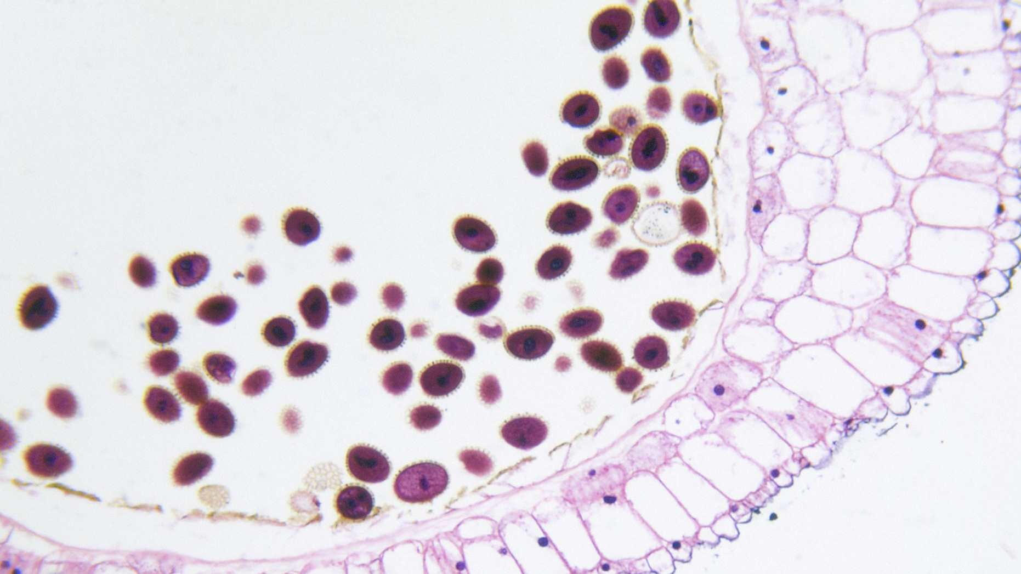
Investigating Heat Stress-Induced Disruption of LCA5L, MYBL1, and MAGEB4 Pathways in Spermatogenesis Using Multi-Omics Data
By: Melanie L Salas

Slide 2
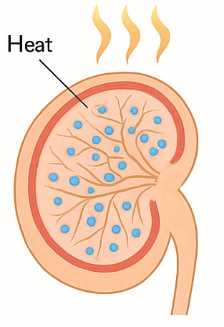
Background: Heat Stress & Male Fertility Disruption
Heat Stress and Spermatogenesis
Disrupts sperm development and fertility
Affects chromatin organization, protein stability, and redox balance
Key Genes: LCA5L, MYBL1, MAGEB4
Regulate chromatin and gene expression
Involved in germ cell survival and response to cellular stress
Knowledge Gap
How does heat stress alter expression and function of these genes?
What are the downstream multi-omics impacts?
Study Importance
Explores molecular mechanisms of infertility
Aims to support biomarker discovery & fertility strategies
Notes:
Spermatogenesis is the process by which sperm are produced in the testes — it relies on precise gene regulation and a stable environment.
Heat stress disrupts spermatogenesis: Damages germ cells by affecting chromatin structure, inducing oxidative stress, and causing protein misfolding. all of which impair fertility.
Key genes in protection: LCA5L, MYBL1, MAGEB4 play crucial roles in protecting sperm cells from these stresses.
Knowledge Gap: The role of heat stress and the loss of these genes in altering gene expression, chromatin structure, and cellular stress is not fully understood.
Study Aim: Investigating these mechanisms to improve fertility preservation strategies.
LCA5L maintains sperm cell structure.
MYBL1 controls gene expression during sperm development.
MAGEB4 helps manage stress and protein stability.
The knowledge gap: how heat stress and loss of these genes together disrupt spermatogenesis.
This study aims to reveal these mechanisms and support strategies to protect male fertility.

Slide 3
Research Question
How does heat stress alter gene expression and chromatin structure in germ cells?
What role do LCA5L, MYBL1, and MAGEB4 play under heat stress?
How does loss of these genes amplify oxidative stress and protein damage?

Slide 4
Study Objectives
Investigate how heat stress disrupts spermatogenesis via LCA5L, MYBL1, and MAGEB4.
Use multi-omics data (RNA-Seq, ATAC-Seq) to assess changes in gene expression and chromatin structure.
Analyze oxidative stress and protein aggregation in knockout germ cells.

Slide 5
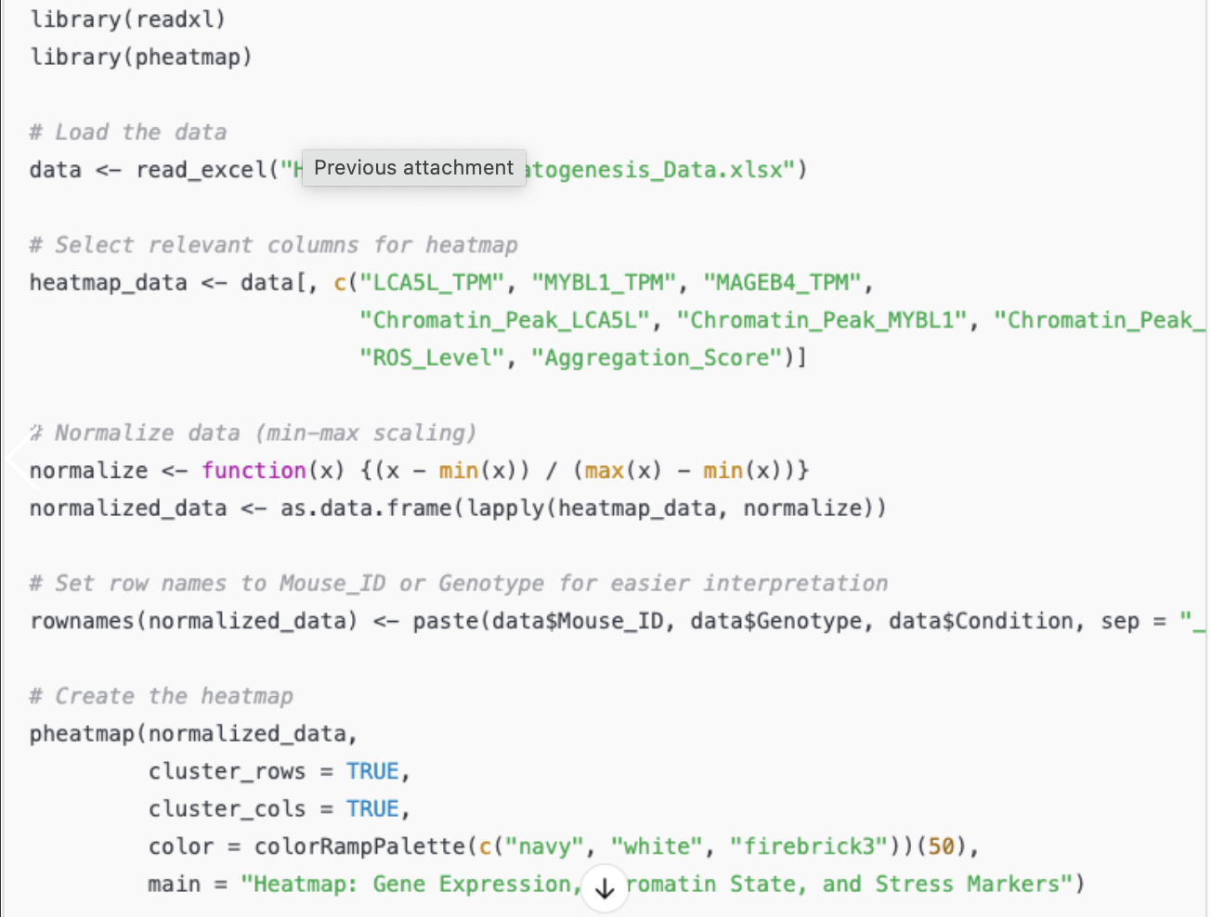
Code Ran

Slide 6
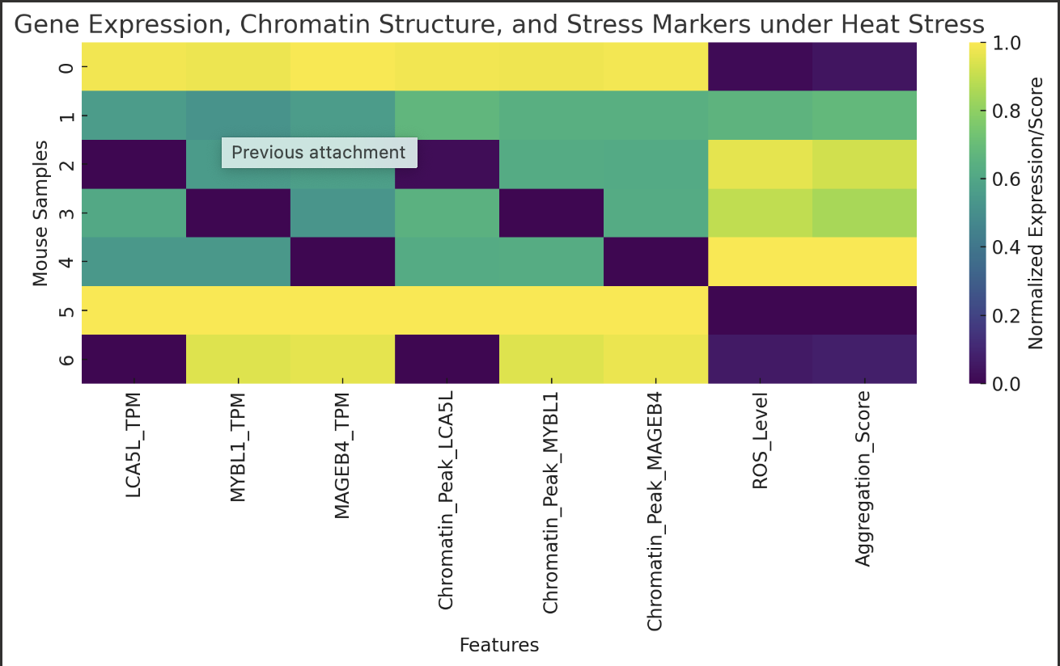
Notes:
This heatmap shows gene expression, chromatin accessibility, ROS, and aggregation across different mouse samples.
WT-Control shows high gene activity and low stress.
WT-Heat shows reduced expression and increased ROS and aggregation.
Knockouts (LCA5L, MYBL1, MAGEB4) show drastic loss of gene function and the highest stress levels.
This confirms these genes are protective during heat stress and help limit damage.

Slide 7
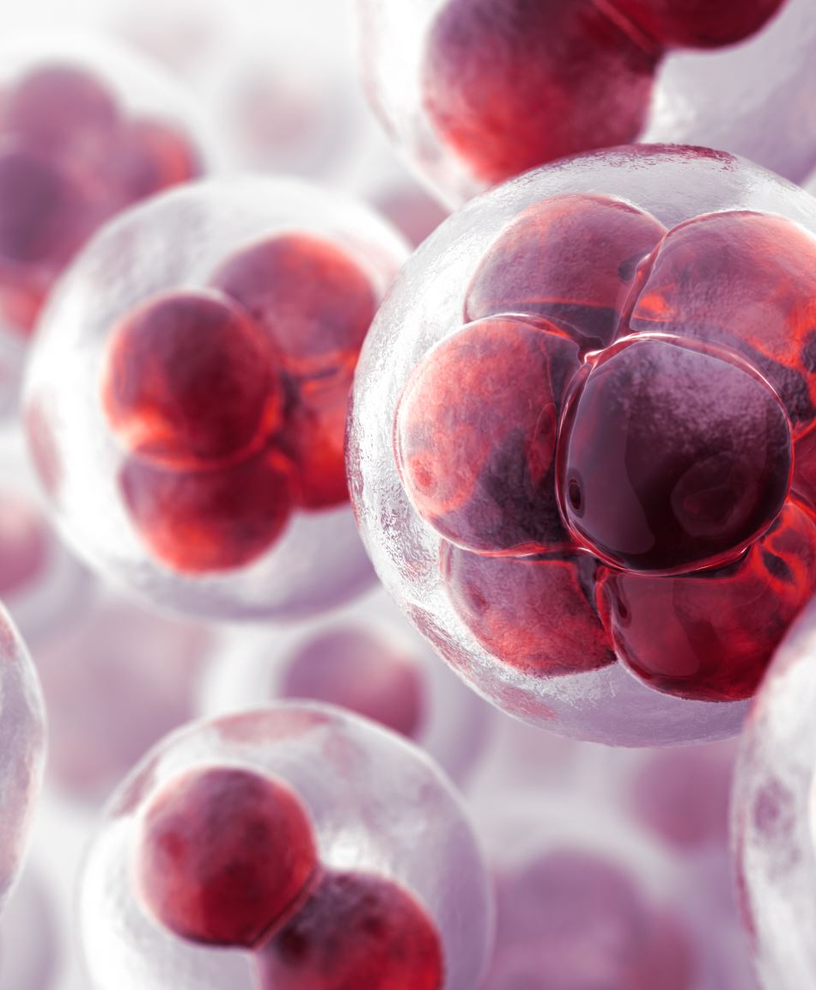
Conclusion
Heat stress reduces gene expression and chromatin accessibility in germ cells.
LCA5L, MYBL1, and MAGEB4 are essential for maintaining transcription and chromatin structure during heat stress.
Loss of these genes worsens stress responses, increasing oxidative damage and protein aggregation.
Overall, these genes play a protective role in preserving germ cell function under thermal stress.
Notes:
Heat stress reduces gene expression and chromatin accessibility in germ cells.
LCA5L, MYBL1, and MAGEB4 help maintain transcription and chromatin structure during this stress.
When these genes are lost, oxidative damage and protein aggregation increase.
This shows they play a protective role in preserving germ cell function under heat stress.

Slide 8

Thank you

Slide 9
References
Love, M. I., Huber, W., & Anders, S. (2014, December 5). Moderated estimation of fold change and dispersion for RNA-seq data with DESEQ2 - Genome Biology. BioMed Central. https://genomebiology.biomedcentral.com/articles/10.1186/s13059-014-0550-8
QY;, Y. G. L. Y. (n.d.). Clusterprofiler: An R package for comparing biological themes among gene clusters. Omics : a journal of integrative biology. https://pubmed.ncbi.nlm.nih.gov/22455463/
Limma powers differential expression analyses for RNA-sequencing and microarray studies | nucleic acids research | oxford academic. (n.d.). https://academic.oup.com/nar/article/43/7/e47/2414268
Gan M;Jing Y;Xie Z;Ma J;Chen L;Zhang S;Zhao Y;Niu L;Wang Y;Li X;Zhu L;Shen L; (n.d.). Potential function of testicular micrornas in heat-stress-induced spermatogenesis disorders. International journal of molecular sciences. https://pubmed.ncbi.nlm.nih.gov/37240155/
Life stage-specific effects of heat stress on spermatogenesis and oogenesis in drosophila melanogaster. Journal of Thermal Biology. https://www.sciencedirect.com/science/article/pii/S0306456524002195
Hermann BP, Cheng K, Singh A, Roa-De La Cruz L, Mutoji KN, Chen IC, Gildersleeve H, Lehle JD, Mayo M, Westernströer B, Law NC, Oatley MJ, Velte EK, Niedenberger BA, Fritze D, Silber S, Geyer CB, Oatley JM, McCarrey JR. The Mammalian Spermatogenesis Single-Cell Transcriptome, from Spermatogonial Stem Cells to Spermatids. Cell Rep. 2018 Nov 6;25(6):1650-1667.e8. doi: 10.1016/j.celrep.2018.10.026. PMID: 30404016; PMCID: PMC6384825.

